Slide 1

8020fit.ai sprint 3
FITNESS
FITNESS
FITNESS
FITNESS
FITNESS
FITNESS
FITNESS
Presented by Team fitforce

Slide 2

AGENDA
Feedback adjustments
Problem statement
Project description
Working agreement
Personas
Minimum viable product
technologies
Algorithms
Diagrams
Product Backlog
Sprint 1 + 2 Recap
Sprint 3 backlog
Metrics
Retrospective
Project demo (App & api Screenshots)
GitHub link
Live app demo
AGENDA
AGENDA

Slide 3

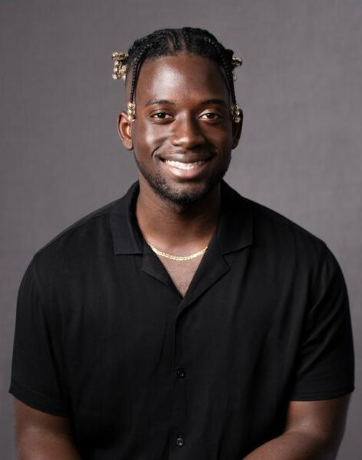

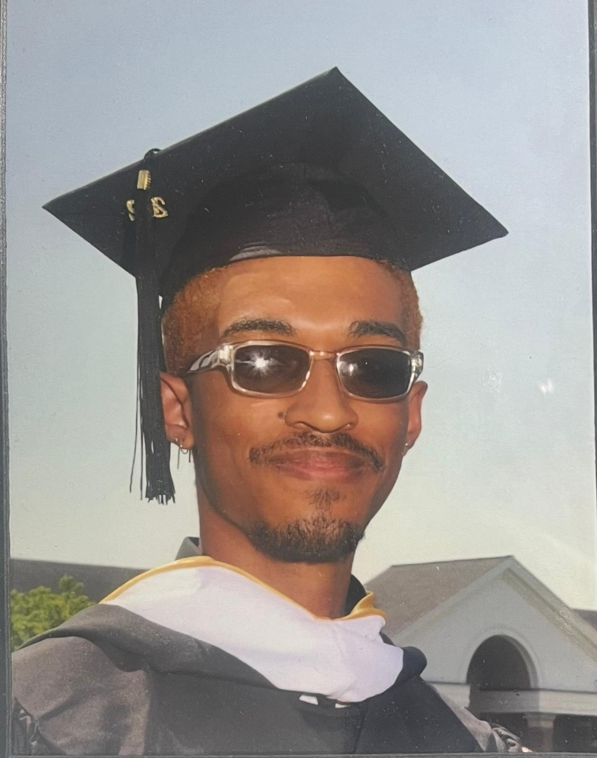
MEET the fitforce team
Adrian egasan
Yaw Mensah
Mustafa al-tameemi
Miguel lugo
Front End Developer
Back End Developer
Back End Developer
Front End Developer

Slide 4

MEET THE FITFORCE TEAM
ROHAN PATEL
Back End Developer

Slide 5
ADJUSTMENTS OF FEEDBACK
Users were clearly identified to specific roles for the user stories

Slide 6

Problem
problem
Problem
People fail to achieve their nutrition and fitness goals due to overcomplicated health/fitness apps, lack of education, hectic lifestyles, expensive personal trainers & gym memberships, and misinformation in the nutrition & fitness industries.

Slide 7

Project
8020FIT.AI is a comprehensive webapp deigned to optimize nutrition and fitness tracking. End users will take an in-depth quiz on what their fitness goals are as well as body measurements and goal body measurements. The AI will then create custom tailored workouts, and meal plans for the user. End users will also be able to log their workouts and macros to see if they’re on track.
Project
Project

Slide 8
MVP (Minimum Viable Product)
User Profile and Registration
a. Obtain user data via onboarding quiz: age, height, weight, fitness goals/experiences, workout preferences
Workout And Meal Plan Regiment/Recommendation – API
a. Workout and Meal Plans are fetched off ExerciseDB API and Spooncular API based off end user quiz metrics
Maintain user friendly webapp
AI Chatbot
a. Develop AI chat bot that can answer FAQs based on fitness

Slide 9
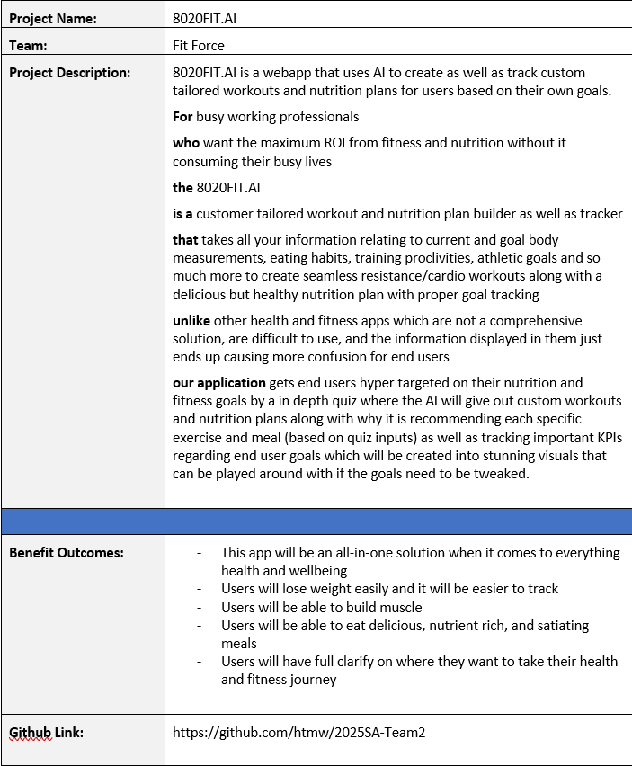

Slide 10
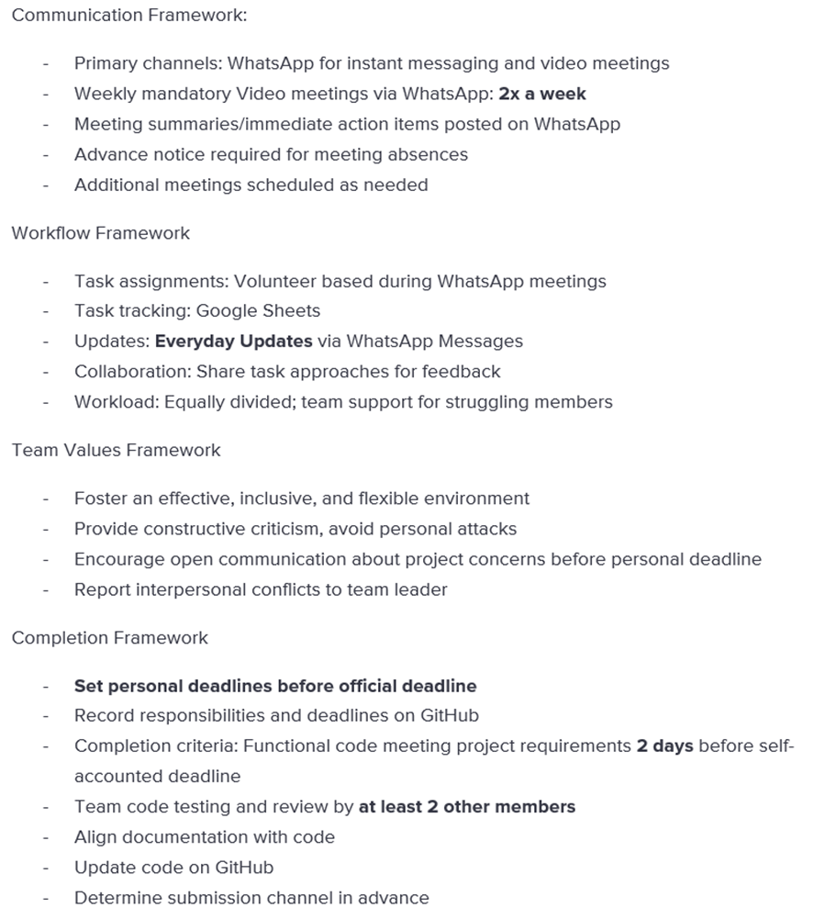
Overview
WORKING AGREEMENT

Slide 11

Working
professional
persona
Age: 28
Occupation: Marketing Manager
Fitness Level: Beginner
Technology Comfort: Moderate
Goals: She wants to increase energy levels and lose weight, prefers quick and efficient workouts.
Challenges: limited time due to a demanding job, limited knowledge about effective workout routines, hard to stay motivated.

Slide 12

college
student
persona
Age: 22
Occupation: Student
Fitness Level: Intermediate
Technology Comfort: High
Goals: Build muscle and increase strength, trying new workout routines.
Challenges: Limited equipment availability at his gym so he prefers body weight and minimal equipment exercises, needs a variety of workouts to prevent boredom

Slide 13

Middle aged
mom
persona
Age: 38
Occupation: Stay at home parent
Fitness Level: Beginner
Technology Comfort: Low to moderate
Goals: Maintaining health and boosting energy for her family, prefers low-impact exercises that can fit around her children’s schedules
Challenges: Finds it challenging to set aside dedicated time for workout, overwhelmed by complex fitness apps, needs workouts that are gentle but effective, due to past injuries

Slide 14
Technologies
Technologies
Technologies
Programming languages
Tools
Back End: Typescript
Front End: React, Typescript
Visual Studio Code
AWS Amplify
BotPress

Slide 15
Technologies
Technologies
Technologies
database
API
AWS DynamoDB
Rapid API (ExerciseDB API)
Spooncular API

Slide 16
algorithms
algorithms
algorithms
Restful data fetching
Rule-Based mapping
Random sampling
To map quiz answers to corresponding exercises and equipments.
To make the exercises vary in order each time the user opens the workout page.
Allows us to get data from a local or remote server via ExerciseDB API
Notes:
What went well:
Quick decision: team members quickly established project idea as well as roles and responsibilities
Flexibility: team members were open to scheduling more meetings than necessary to get in alignment with each other for the project
Clarity: ideas started coming together as soon as the team started executing on respective action items, structuring the information on the slides, and getting clear on the working agreement
What can be improved:
Late planning: led to a rushed feeling, we did not know much about the project until January 25th when we could have started January 21st
Meeting structure: everyone needs to be clear on their own action items as well as other group members action items to be in sync
Communication: proactively letting the group know what they did on the project so other group members quickly test and verify it
What will we implement moving forward:
Implement a framework for our meetings moving forward where we know what exactly each of us is doing in the project at any moment in time
Team members will be asked to use the tracker to give themselves deadlines as well as check when tasks are complete
Update each other once every three days to see where everyone is with their responsibilities

Slide 17
algorithms
algorithms
algorithms
SeT Deduplication and Sampling
Local data storage
Authentication/access control
To avoid redundancies, the user gets a variety of exercises that target different muscle groups.
Saves workout routines based on user's key. Retrieves and updates chosen workouts dynamically.
Secures API and data access using AWS Amplify Auth (Cognito) with role-based access control
Notes:
What went well:
Quick decision: team members quickly established project idea as well as roles and responsibilities
Flexibility: team members were open to scheduling more meetings than necessary to get in alignment with each other for the project
Clarity: ideas started coming together as soon as the team started executing on respective action items, structuring the information on the slides, and getting clear on the working agreement
What can be improved:
Late planning: led to a rushed feeling, we did not know much about the project until January 25th when we could have started January 21st
Meeting structure: everyone needs to be clear on their own action items as well as other group members action items to be in sync
Communication: proactively letting the group know what they did on the project so other group members quickly test and verify it
What will we implement moving forward:
Implement a framework for our meetings moving forward where we know what exactly each of us is doing in the project at any moment in time
Team members will be asked to use the tracker to give themselves deadlines as well as check when tasks are complete
Update each other once every three days to see where everyone is with their responsibilities

Slide 18
algorithms
algorithms
algorithms
Workout history sorting
Demographic-Based Personalization
Horizontal scrolling
Sorting workout by date in descending order so users will see the most recent workout completed
Adjusts workout targeting based on BMI, age, gender, and body type.
Using a flexbox layout, allows the user to view history from left to right for ease of viewing
Notes:
What went well:
Quick decision: team members quickly established project idea as well as roles and responsibilities
Flexibility: team members were open to scheduling more meetings than necessary to get in alignment with each other for the project
Clarity: ideas started coming together as soon as the team started executing on respective action items, structuring the information on the slides, and getting clear on the working agreement
What can be improved:
Late planning: led to a rushed feeling, we did not know much about the project until January 25th when we could have started January 21st
Meeting structure: everyone needs to be clear on their own action items as well as other group members action items to be in sync
Communication: proactively letting the group know what they did on the project so other group members quickly test and verify it
What will we implement moving forward:
Implement a framework for our meetings moving forward where we know what exactly each of us is doing in the project at any moment in time
Team members will be asked to use the tracker to give themselves deadlines as well as check when tasks are complete
Update each other once every three days to see where everyone is with their responsibilities

Slide 19

CaDence
Meetings Twice a Week
weekly
spr 000
January 25 – February 10
Cadence
spr 001
February 10 – March 10
Cadence
spr 002
March 10 – April 7
Spr 003
April 7 – May 5

Slide 20
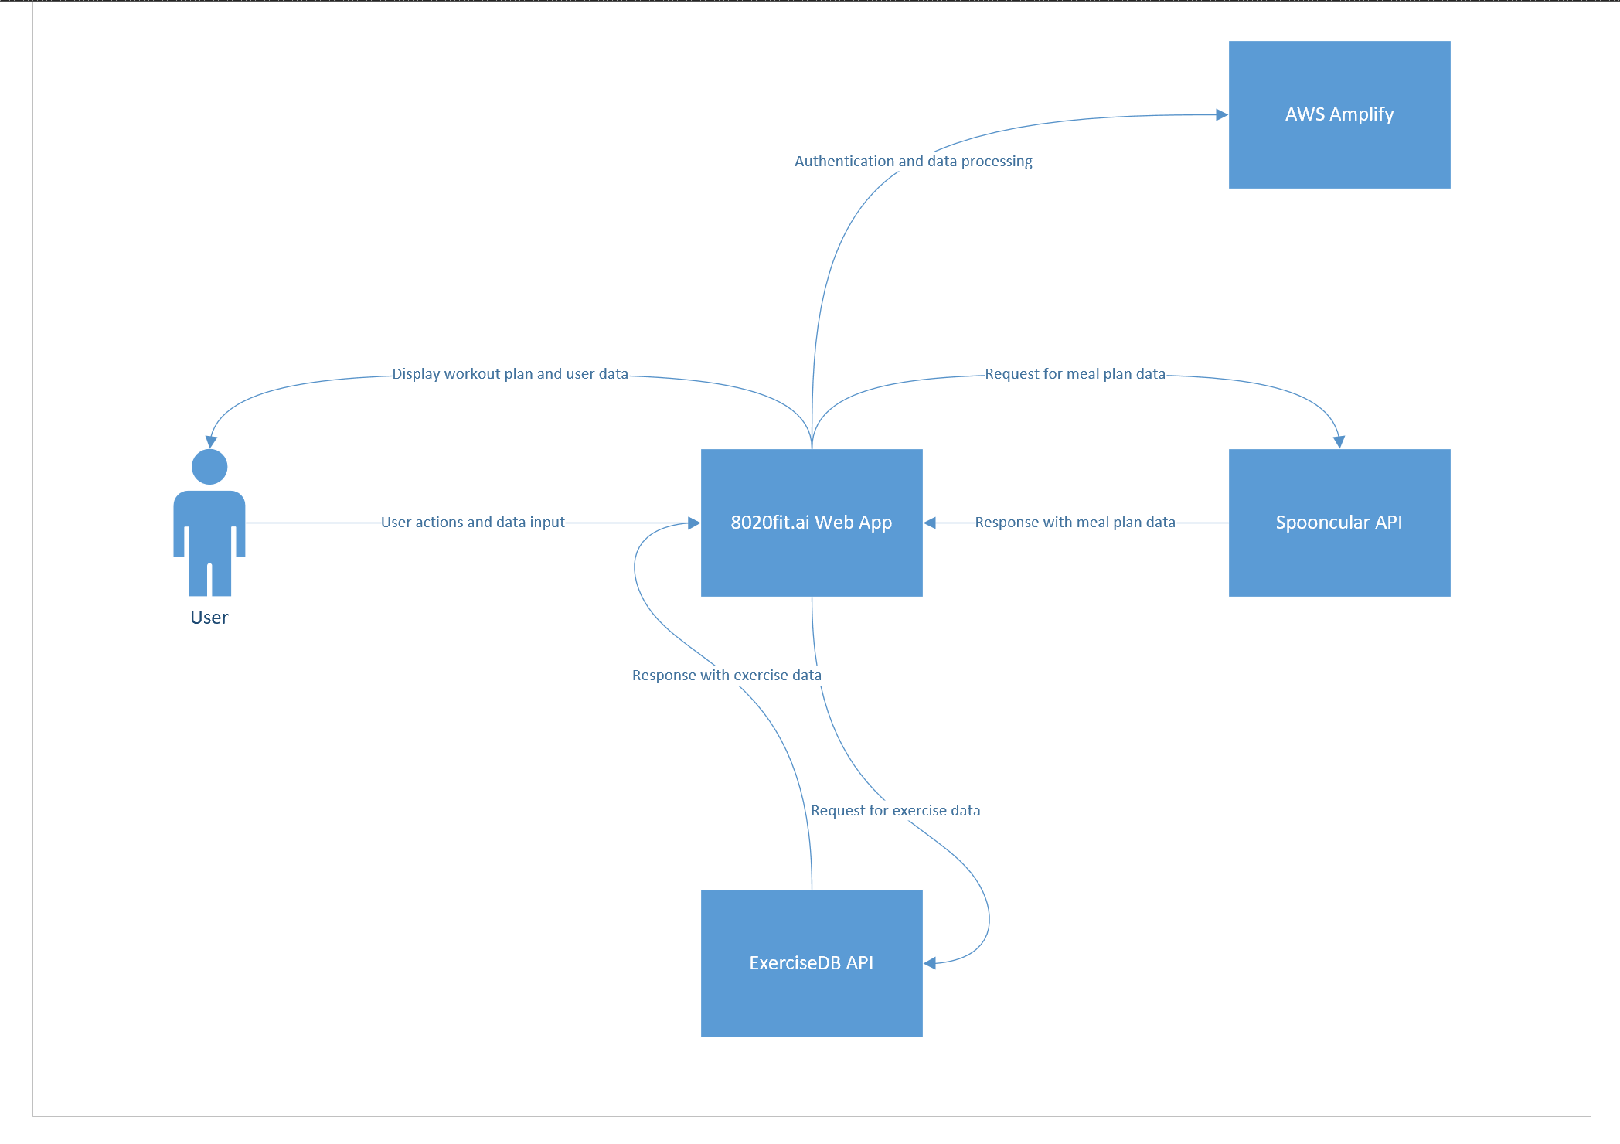
Context Diagram

Slide 21
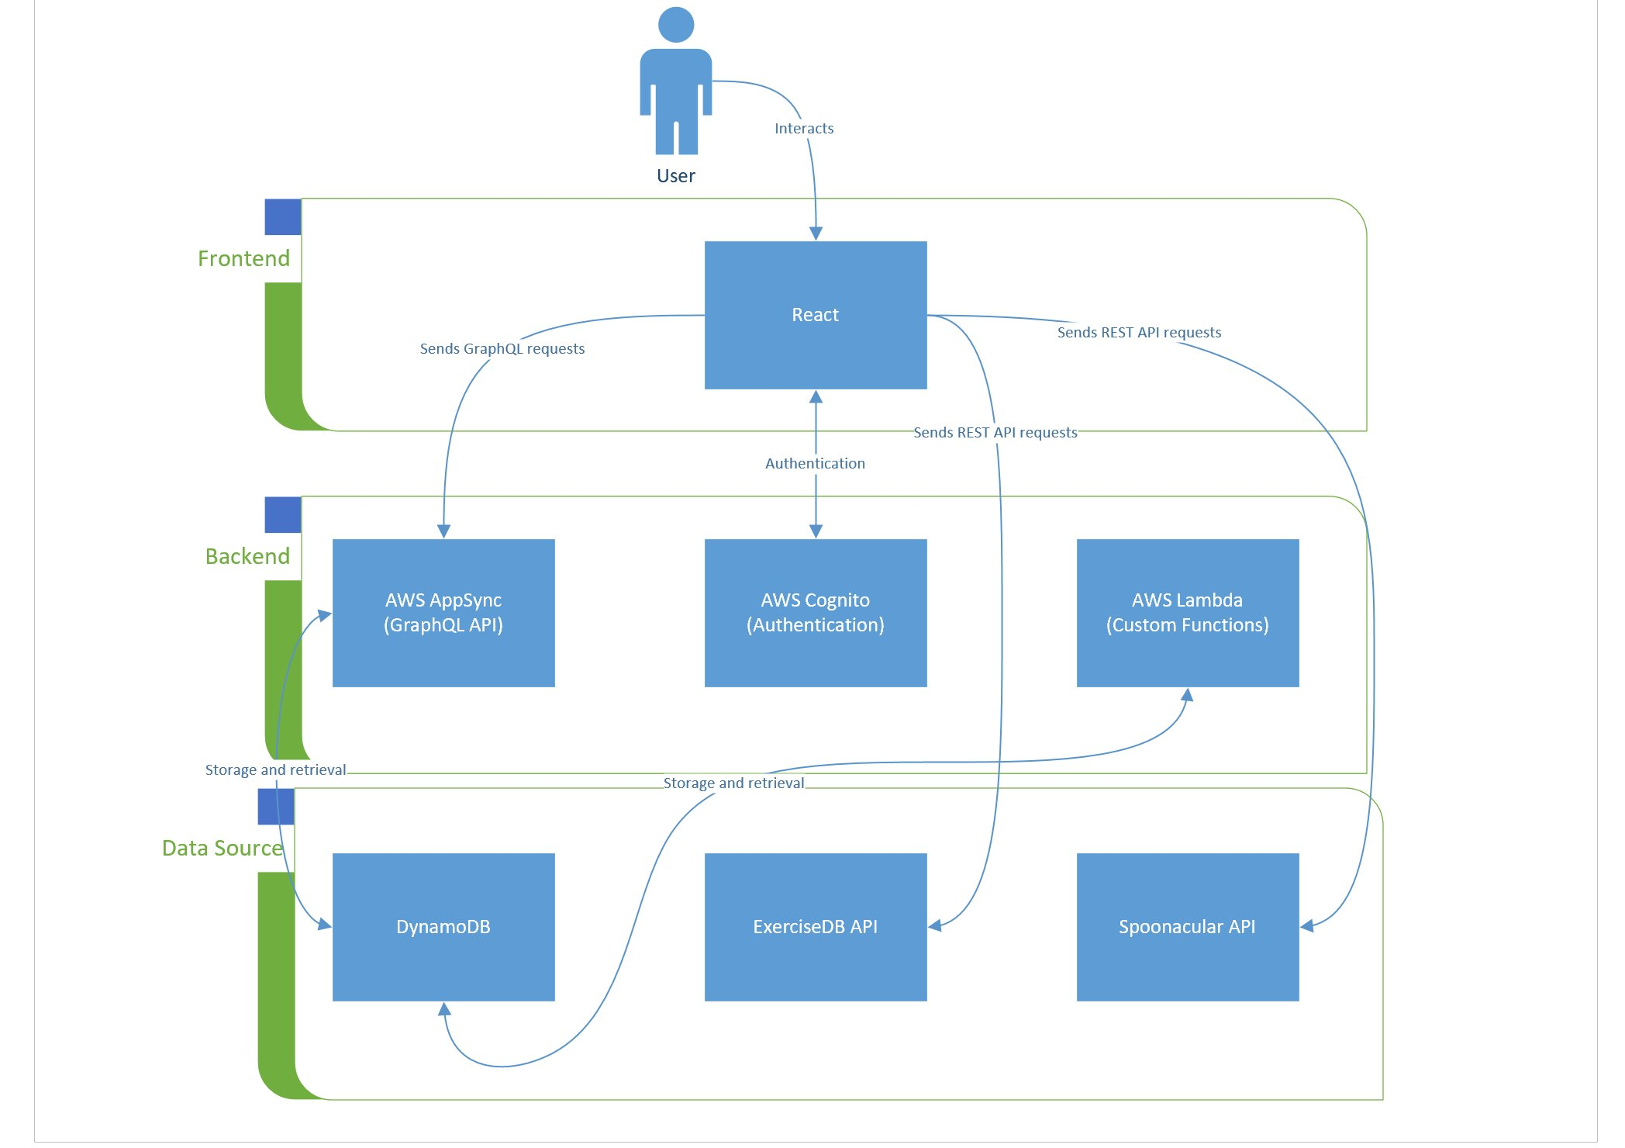
Architecture Diagram

Slide 22
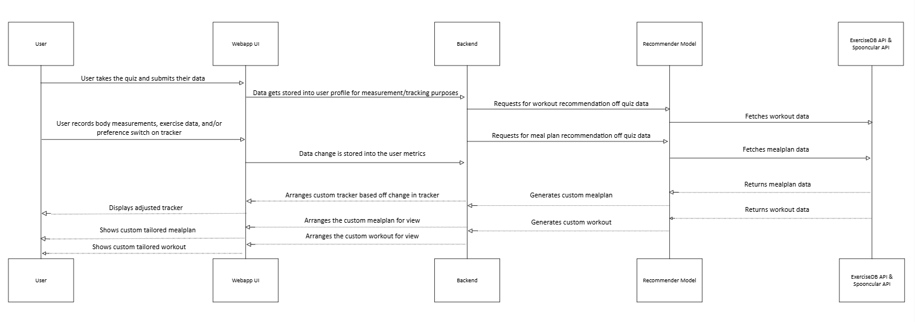
Sequence diagram

Slide 23
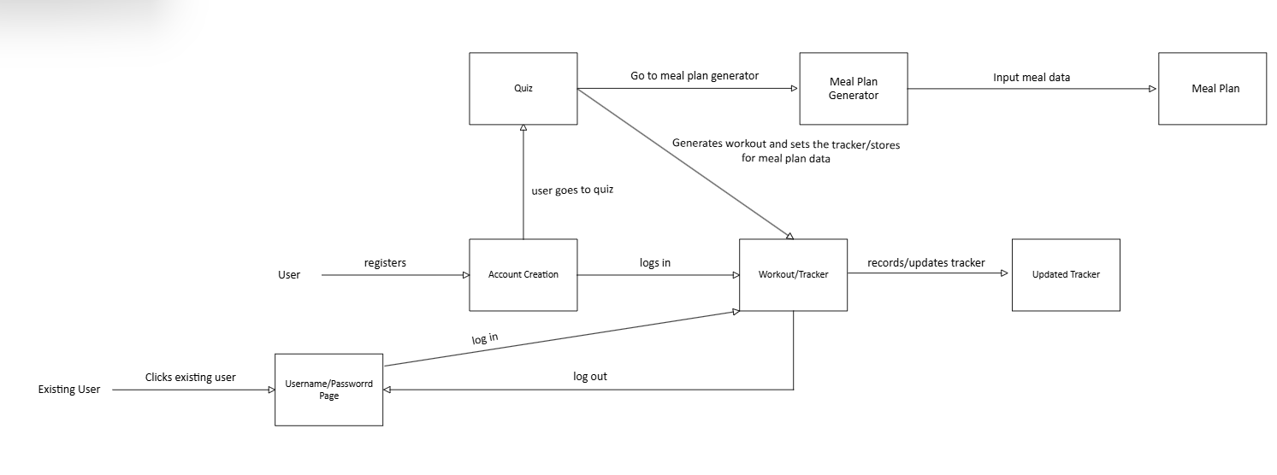
state diagram

Slide 24
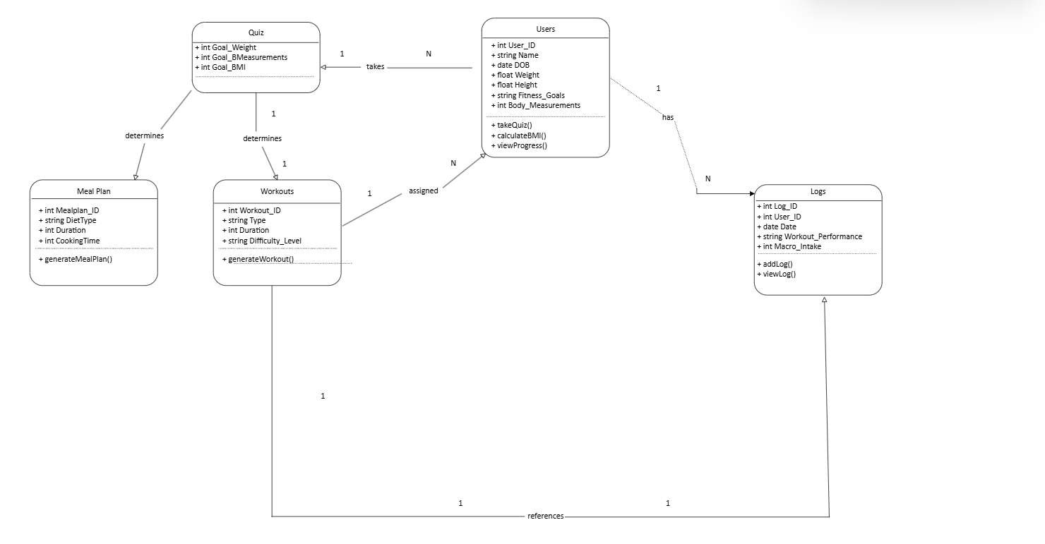
Class diagram

Slide 25
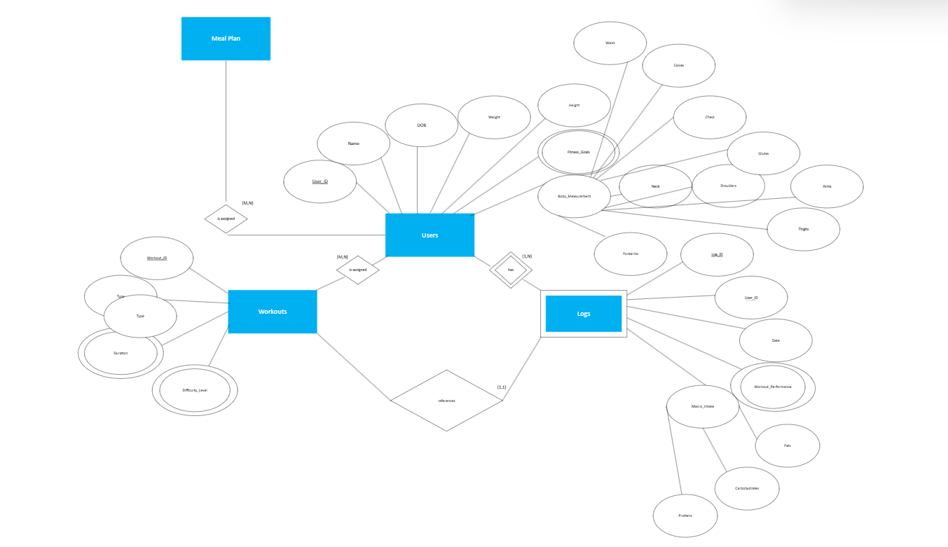
er diagram

Slide 26
Sprint 1 Recap
Created delete account function
Workout tracker for exercises established
Generated workout based on the quiz data from fitness user
Finalized front-end design for web app
Developed product features and requirements

Slide 27
Sprint 2 Recap
Admin features to manage user accounts and platform
Implemented AI chat feature
Provided meal plan recommendations
Ensured user friendly app
Updated capability to select multiple workouts from recommenation
Video generation for workouts

Slide 28
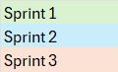
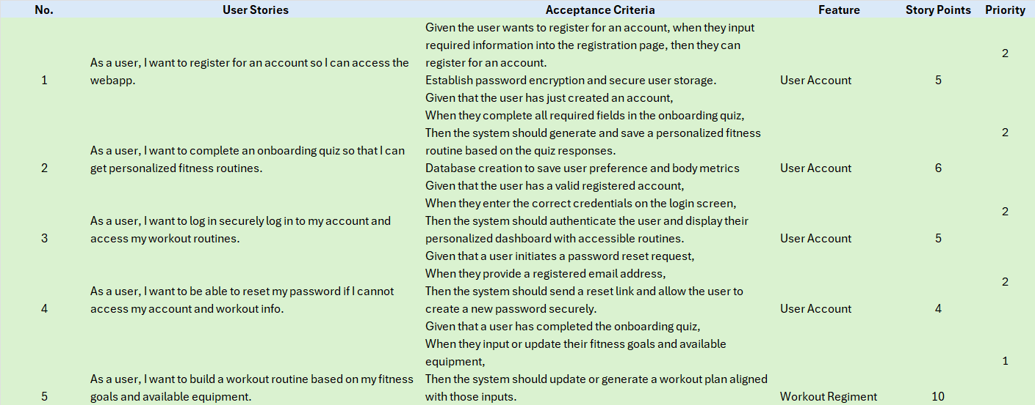
Product Backlog

Slide 29
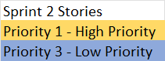
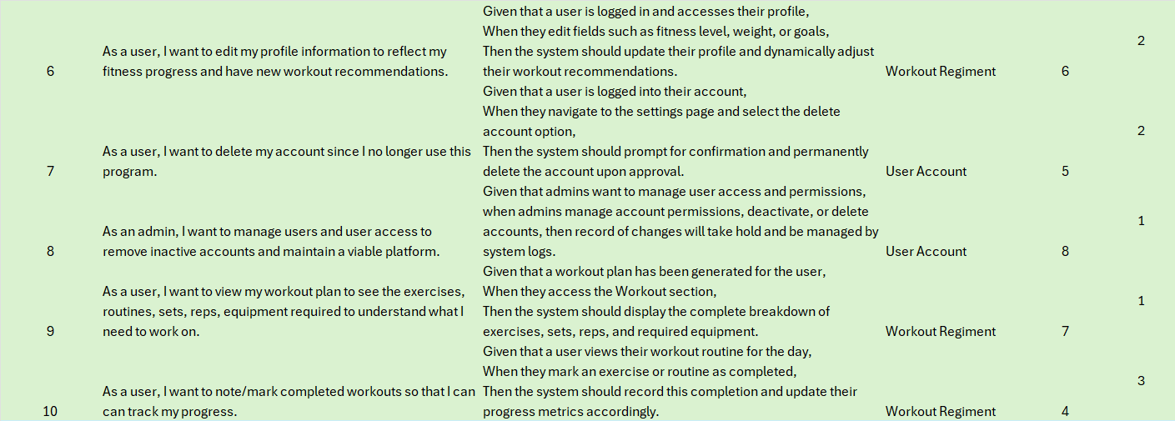
Product Backlog (cont'd)

Slide 30
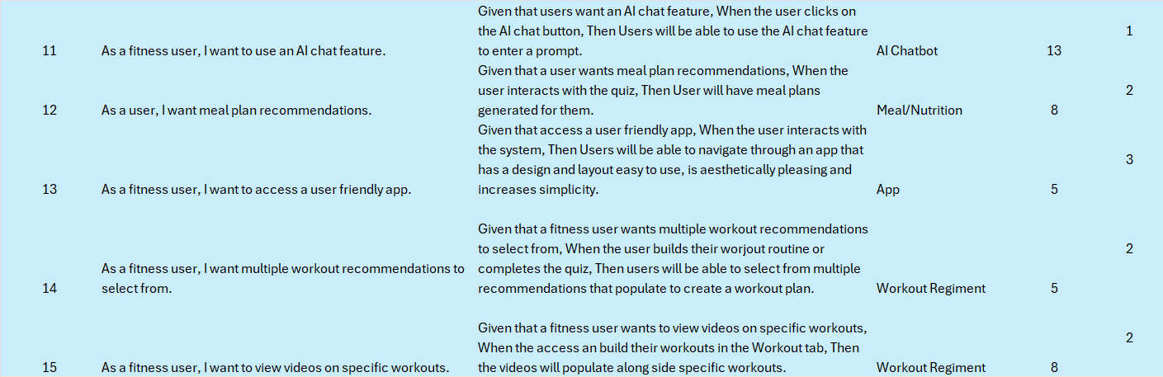
Product Backlog (cont'd)

Slide 31
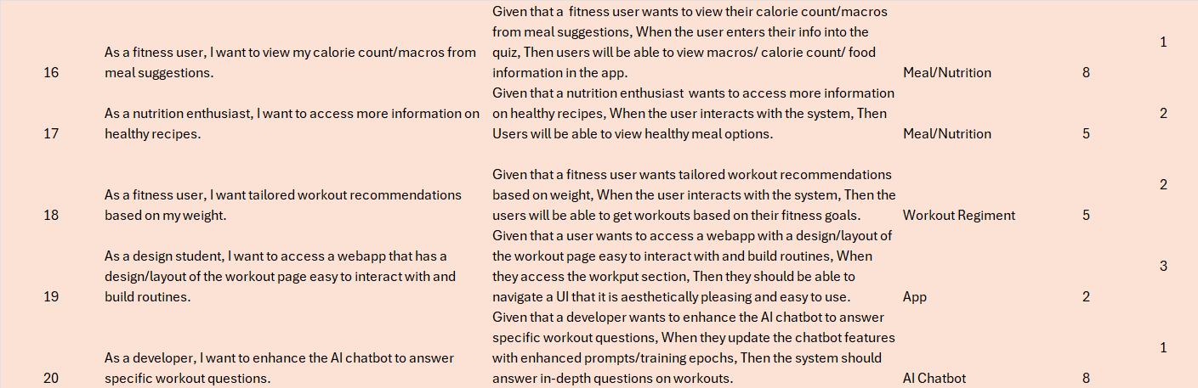
Product Backlog (cont'd)

Slide 32
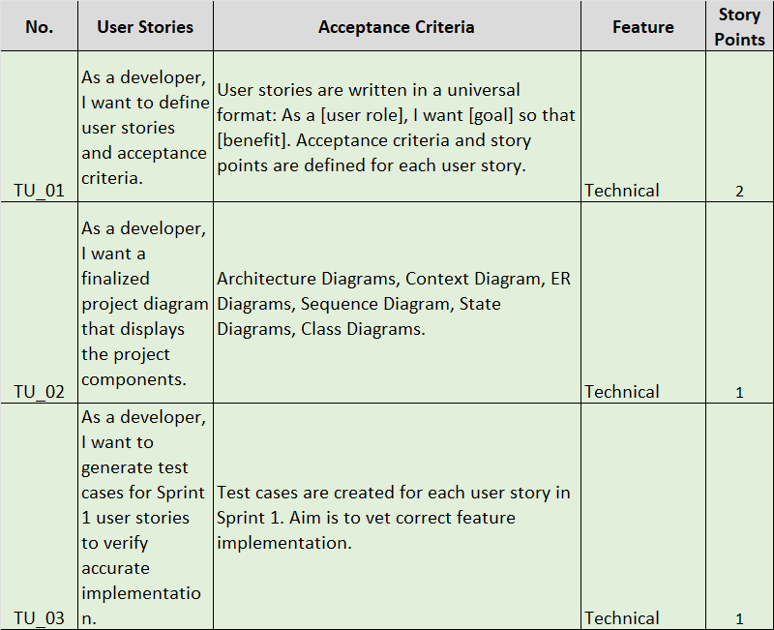
Sprint 3 - Technical User Stories

Slide 33
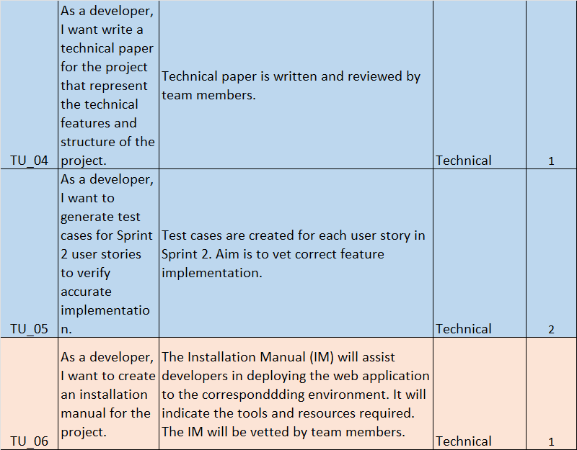
Sprint 3 - Technical User Stories

Slide 34
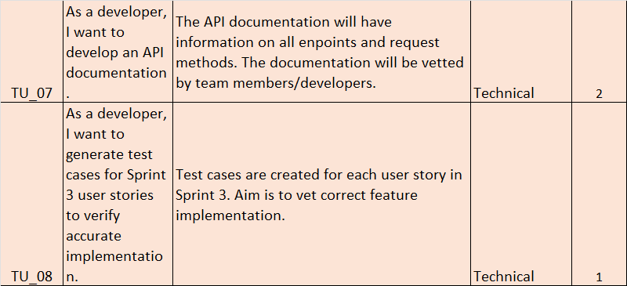
Sprint 3 - Technical User Stories

Slide 35
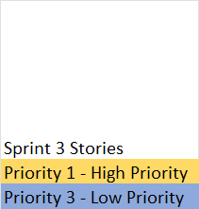
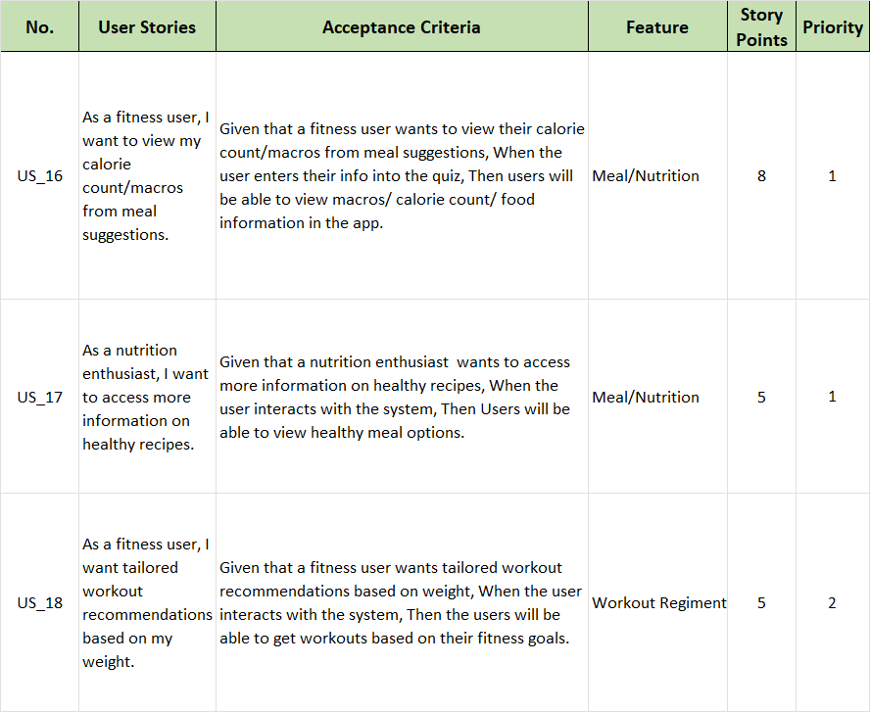
Sprint 3 Stories

Slide 36
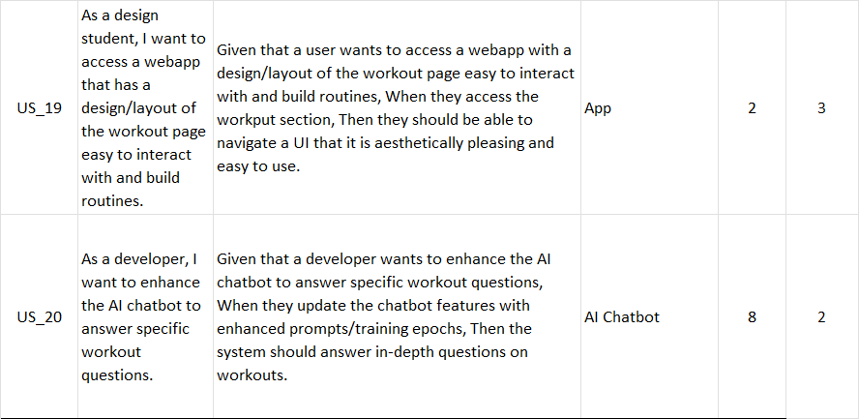
Sprint 3 Stories (cont'd)

Slide 37
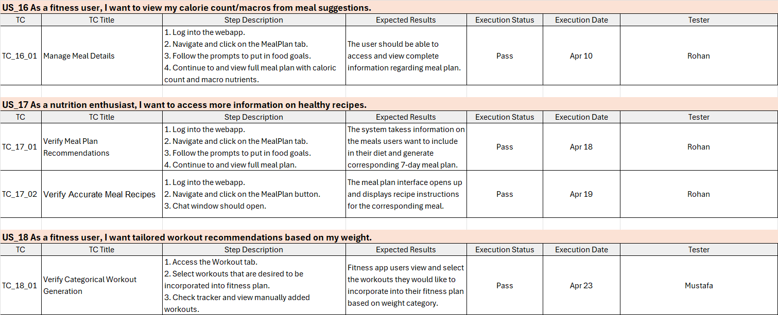
Sprint 3 Test Cases

Slide 38
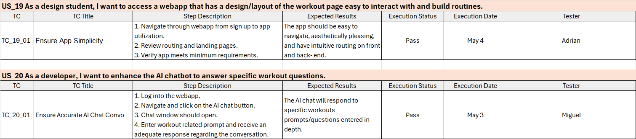
Sprint 3 Test Cases (cont'd)

Slide 39
Sprint 3 Stories Completed and Not
US_ID | User Stories | Completed Date | Story Points | Completed
US_16 | As a fitness user, I want to view my calorie count/macros from meal suggestions. | Apr 10 | 8 | 8
US_17 | As a nutrition enthusiast, I want to access more information on healthy recipes. | Apr 19 | 5 | 5
US_18 | As a fitness user, I want tailored workout recommendations based on my weight. | Apr 23 | 5 | 5

Slide 40
Sprint 3 Stories Completed and Not
US_ID | User Stories | Completed Date | Story Points | Completed
US_19 | As a design student, I want to access a webapp that has a design/layout of the workout page easy to interact with and build routines. | May 4 | 2 | 2
US_20 | As a developer, I want to enhance the AI chatbot to answer specific workout questions. | May 3 | 8 | 8

Slide 41
Team Velocity
Sprint 3 Velocity
Total Story Points: 28
Velocity: 28 story points completed.

Slide 42
Team Historical & Average Velocity
Sprint 1 Velocity: 53 story points completed
Sprint 2 Velocity: 47 story points completed
Sprint 3 Velocity: 28 story points completed
Average Velocity: (53 + 47 + 28) / 3 = ~43 points

Slide 43
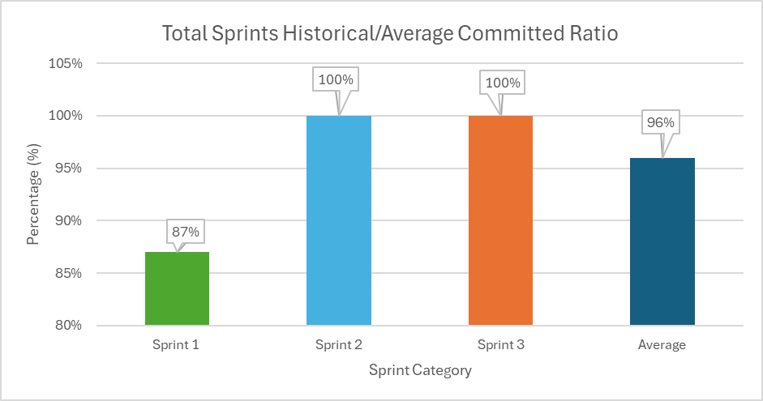
Team Historical & Average Committed Ratio

Slide 44
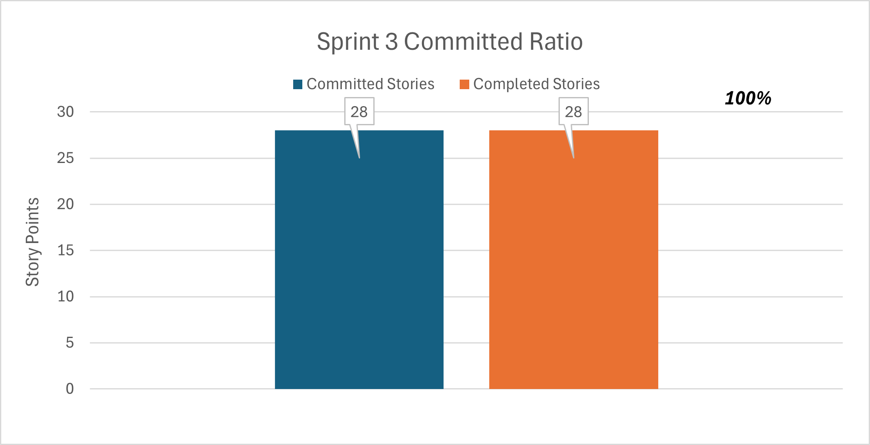
Committed Ratio

Slide 45
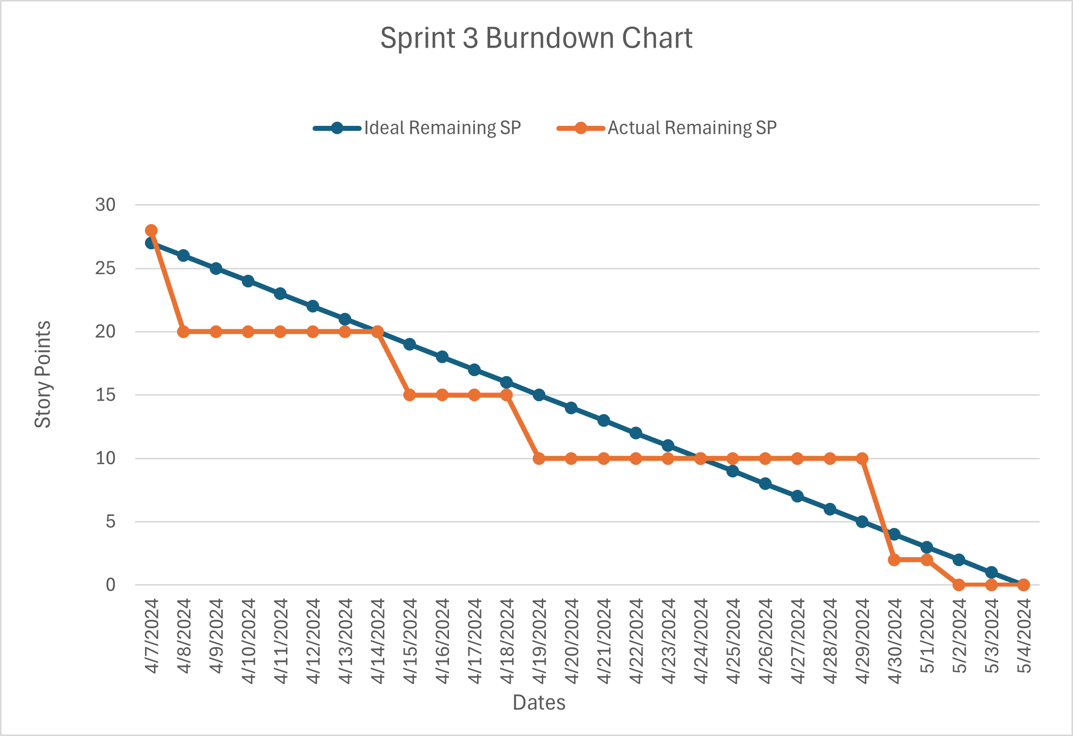
Sprint 3 Burndown Chart

Slide 46
Retrospective
Retrospective
retrospective
Good
Bad
Apply
We came up with extensions of the features that made sense
The customization relating to the workout page and AI bot was nuanced
Front end design work was very simple and organized
We fell of track with weekly meetings
Less communication in the group chats
Some ideas that we could not implement exactly as planned
Pick APIs that are versatile next time
Keep the meeting schedule on a needed basis
Come up with better technical and domain knowledge framework to implement ideas

Slide 47

Screenshot
APP

Slide 48
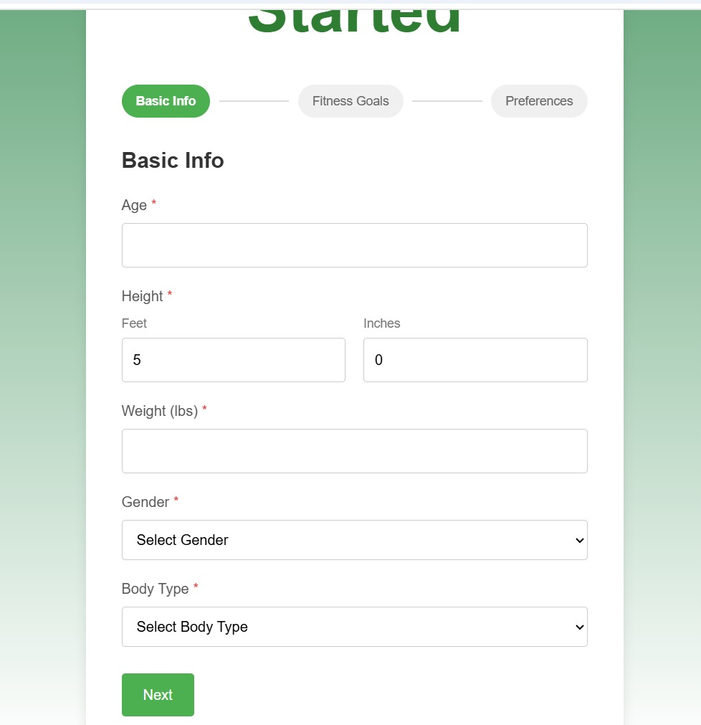
Screenshot
APP

Slide 49
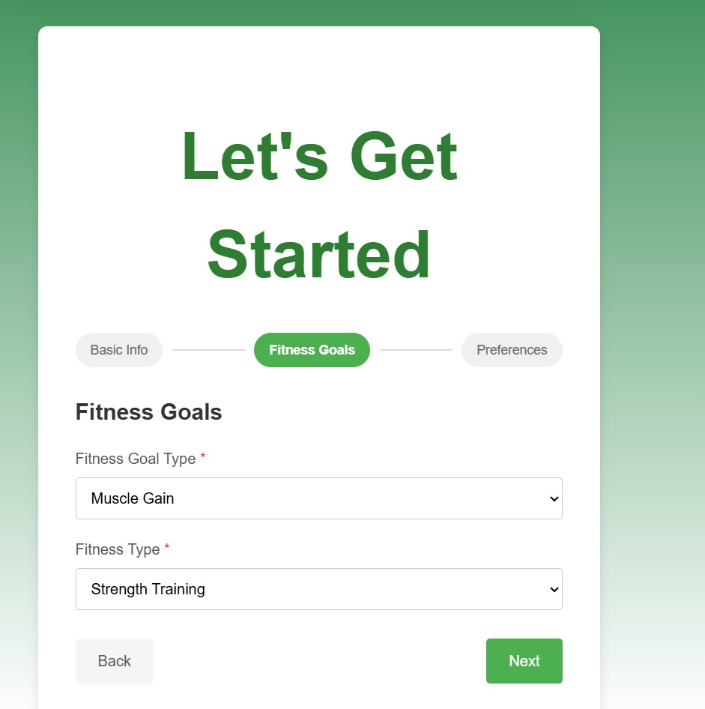
Screenshot
APP

Slide 50
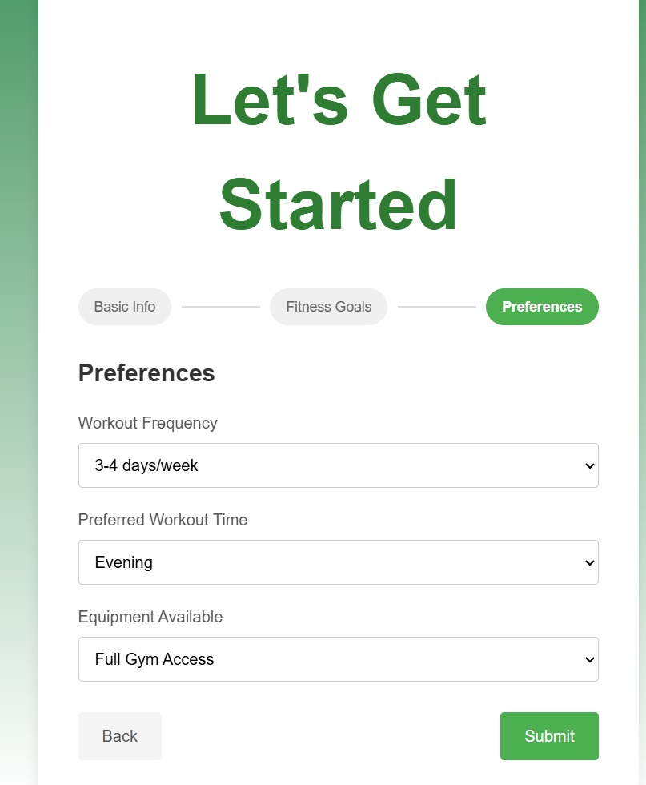
Screenshot
APP

Slide 51
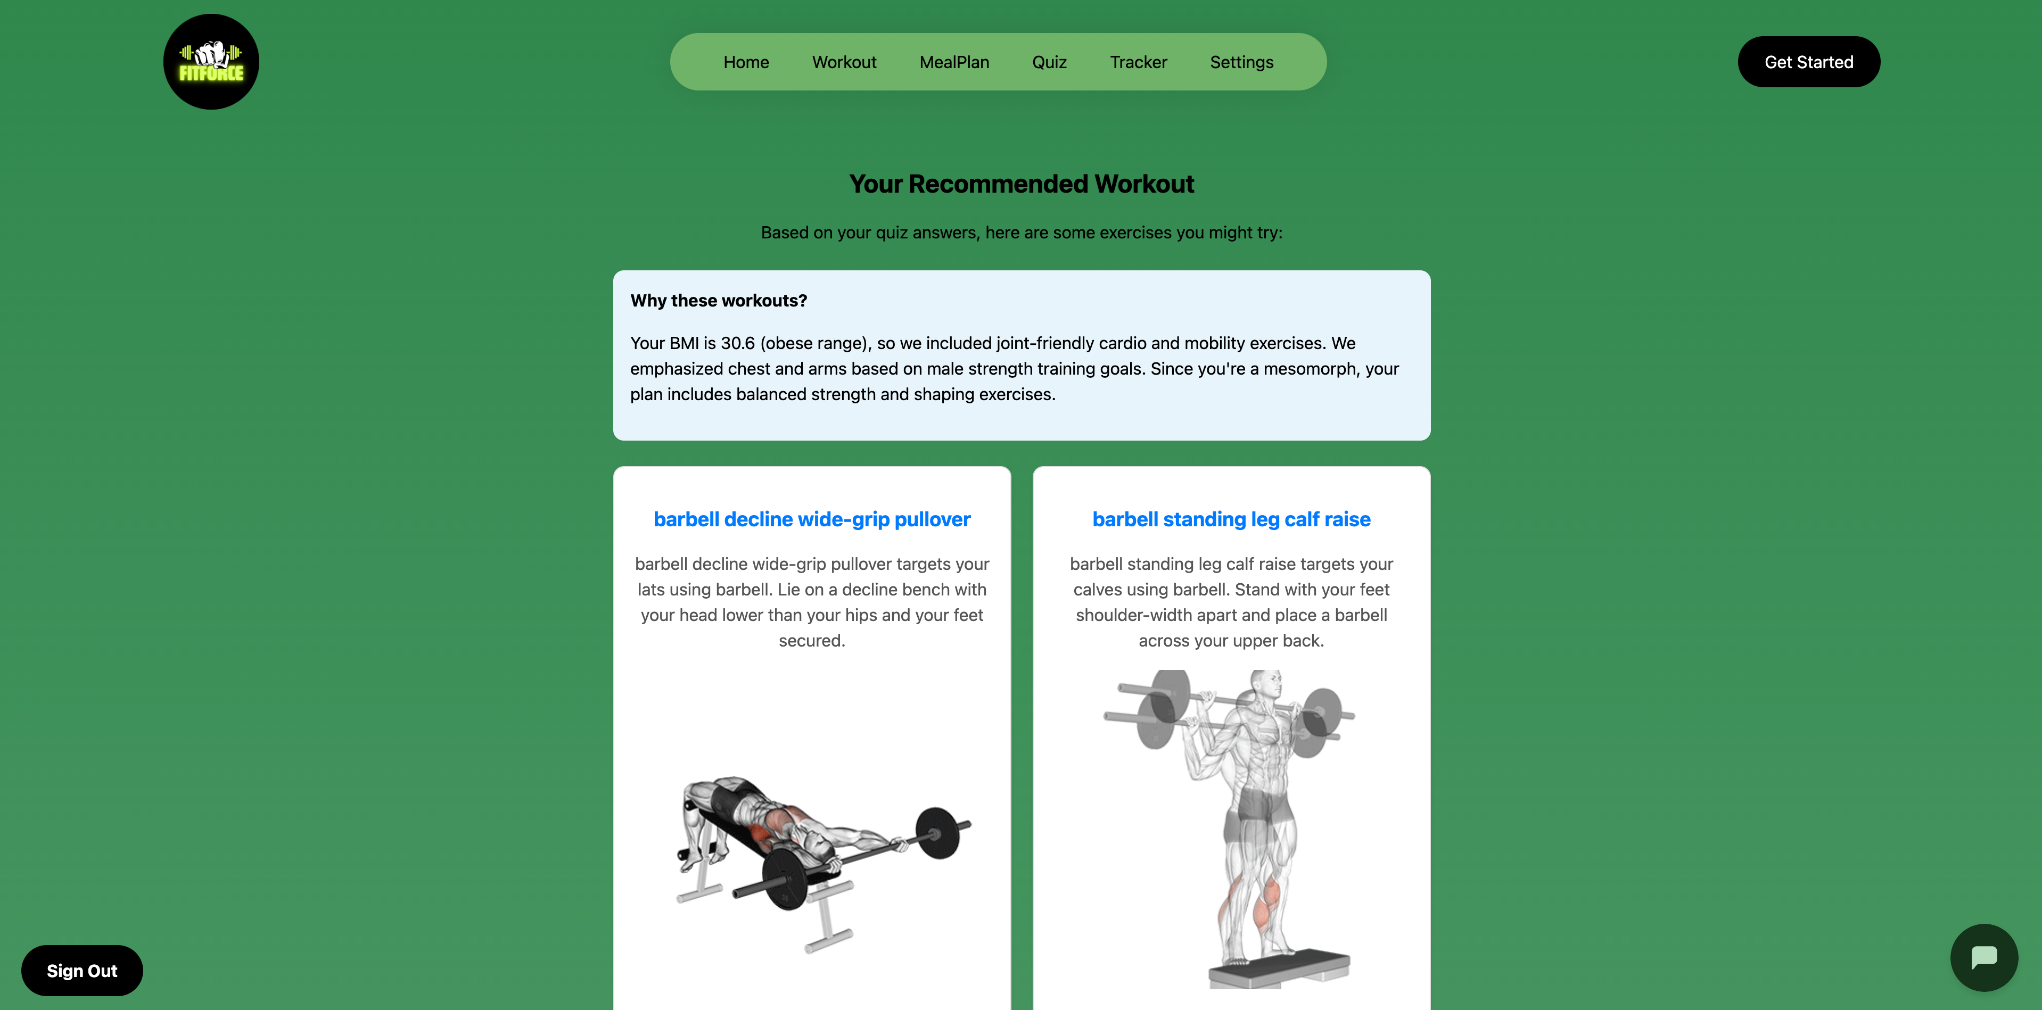
Screenshot
APP

Slide 52
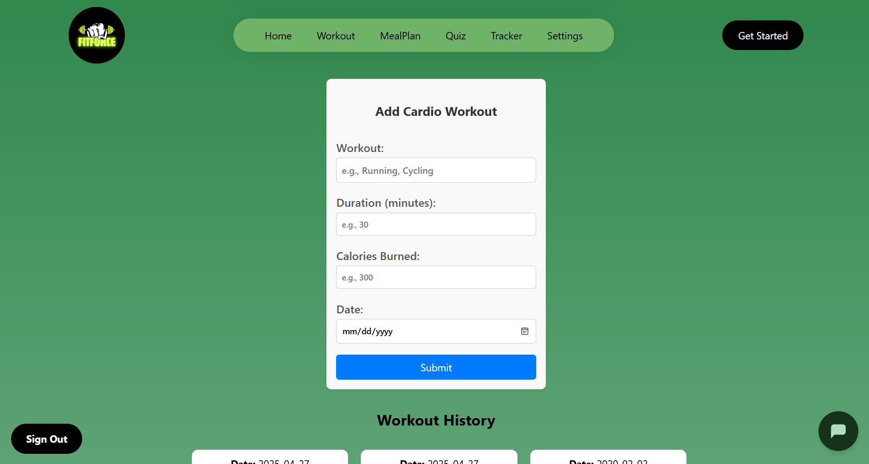
Screenshot
APP

Slide 53
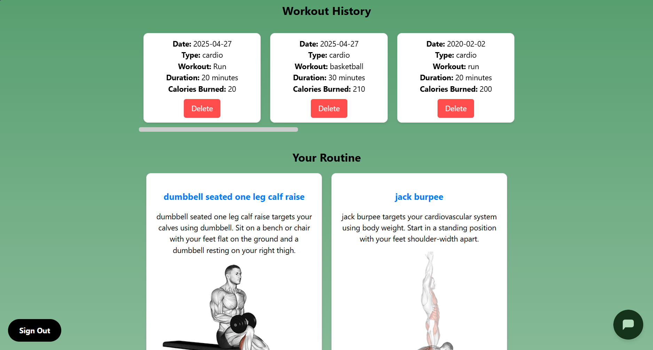
Screenshot
APP

Slide 54

Screenshot
APP

Slide 55
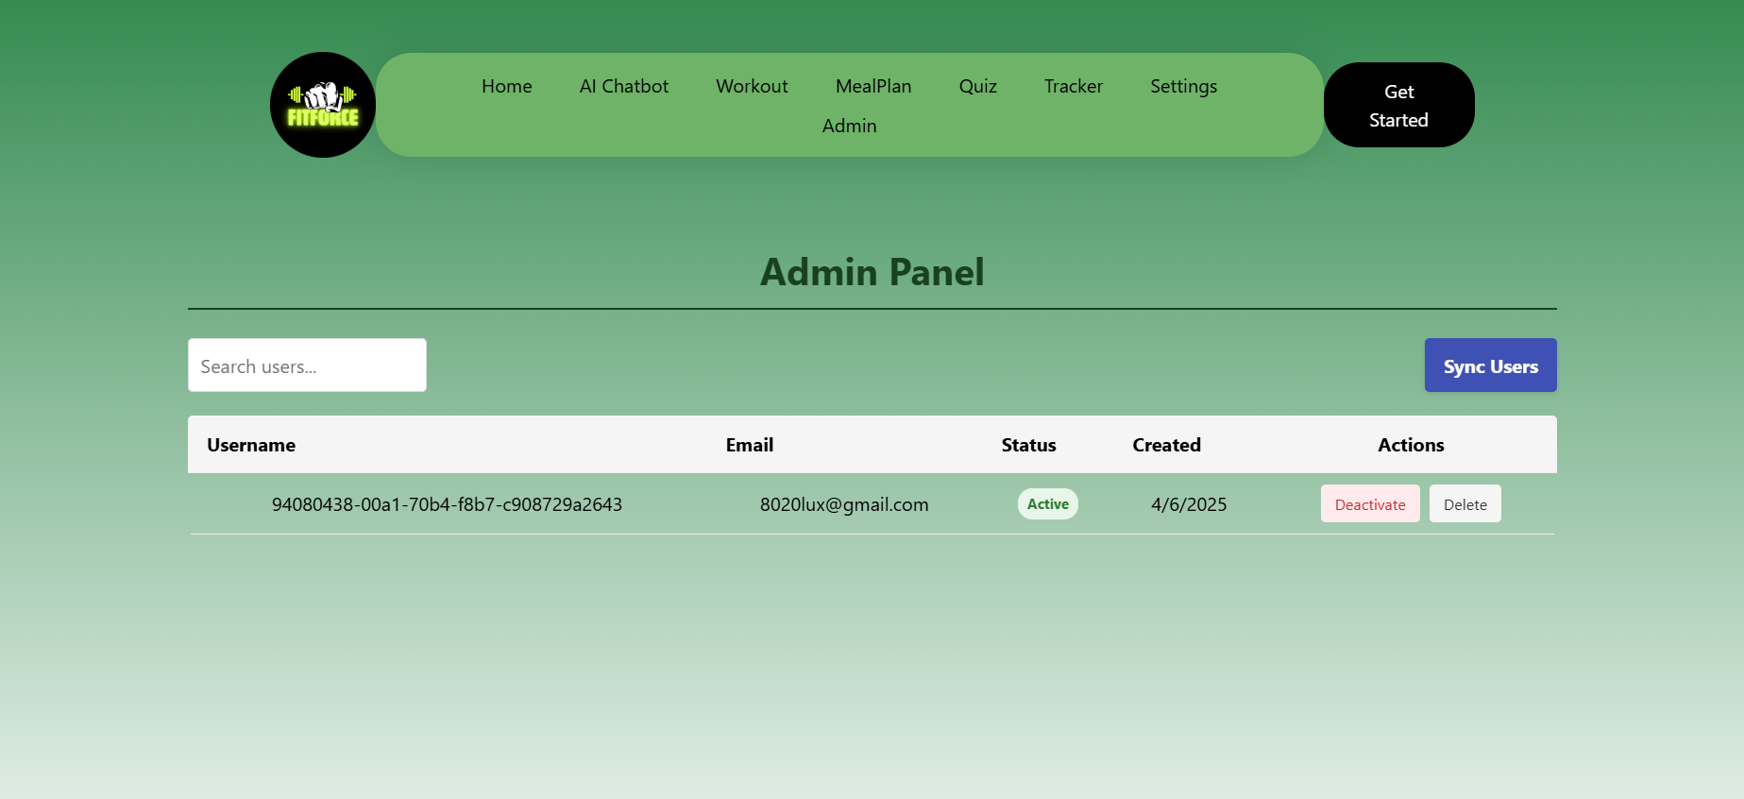
Screenshot
APP

Slide 56
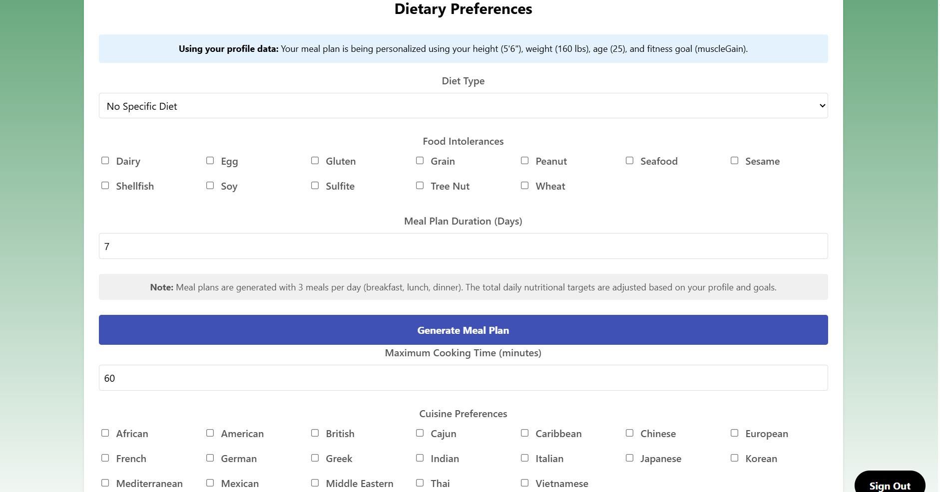
Screenshot
APP

Slide 57
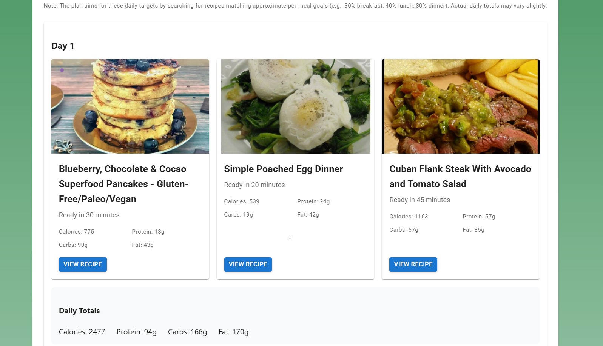
Screenshot
APP

Slide 58
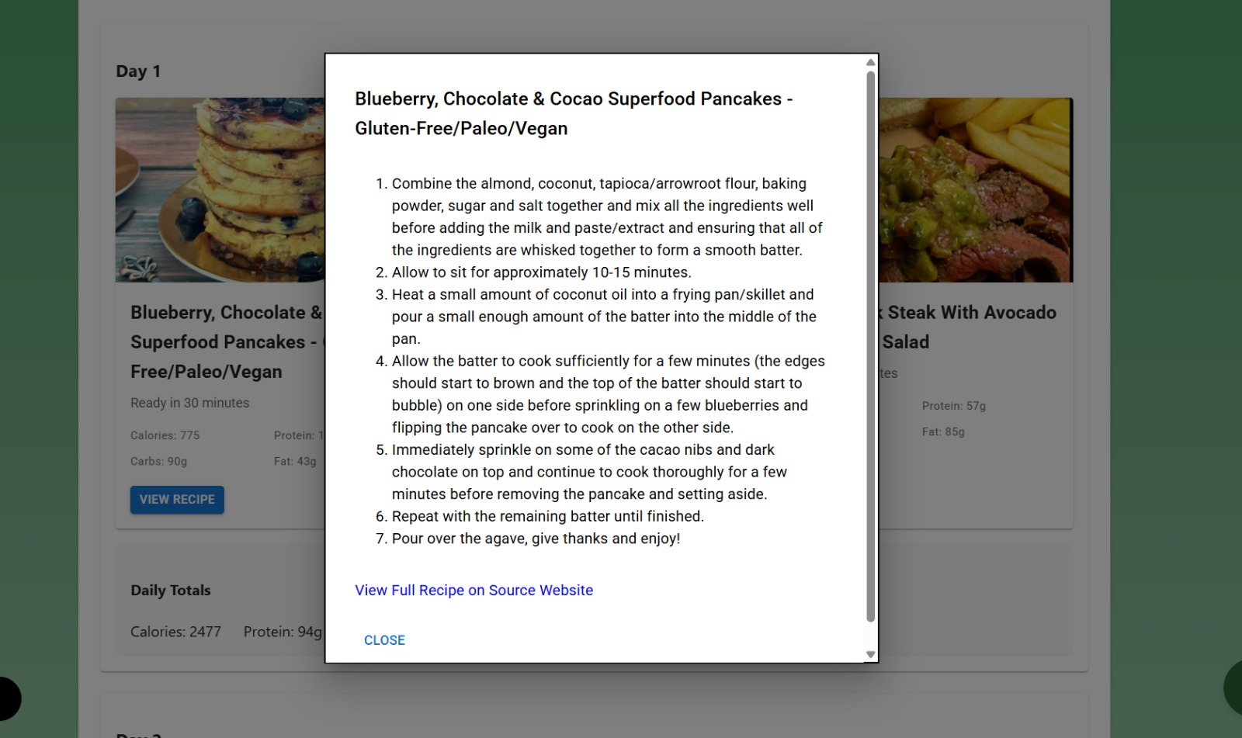
Screenshot
APP

Slide 59
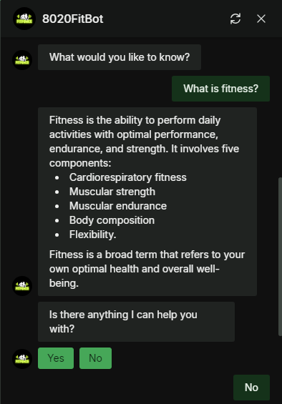
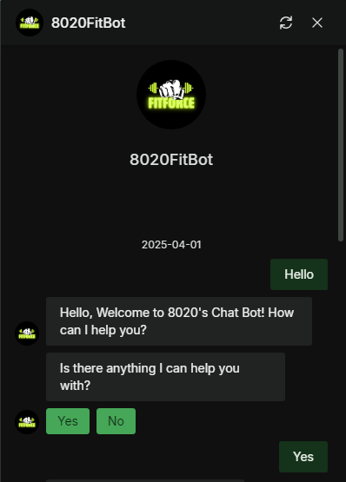
Screenshot
APP

Slide 60
API
API
AWS Amplify API
EXERCISEDB API
AWS Cognito Authentication API
Type: GraphQL API
Purpose: Manages user onboarding data (storing fitness preferences, goals, etc.).
How it Works:
AWS Amplify automatically generates GraphQL API endpoints to interact with DynamoDB.
Instead of manually sending HTTP GET or POST requests (like in Axios), Amplify abstracts API calls through its client models.
Type: REST API
Purpose: Fetches exercise recommendations based on user preferences.
How it Works:
The app makes GET requests to the ExerciseDB API to retrieve exercise data that matches user preferences.
This is done through fetch() in the Workout.tsx component.
Type: Authentication API
Purpose: Manages user authentication (sign-up, login, and identity verification).
How it Works:
AWS Cognito handles authentication and returns a user token after login.
This token is used to authorize API requests to Amplify's backend.
Notes:
What went well:
Quick decision: team members quickly established project idea as well as roles and responsibilities
Flexibility: team members were open to scheduling more meetings than necessary to get in alignment with each other for the project
Clarity: ideas started coming together as soon as the team started executing on respective action items, structuring the information on the slides, and getting clear on the working agreement
What can be improved:
Late planning: led to a rushed feeling, we did not know much about the project until January 25th when we could have started January 21st
Meeting structure: everyone needs to be clear on their own action items as well as other group members action items to be in sync
Communication: proactively letting the group know what they did on the project so other group members quickly test and verify it
What will we implement moving forward:
Implement a framework for our meetings moving forward where we know what exactly each of us is doing in the project at any moment in time
Team members will be asked to use the tracker to give themselves deadlines as well as check when tasks are complete
Update each other once every three days to see where everyone is with their responsibilities

Slide 61


API
API
Spooncular API
Type: REST API
Purpose: Fetches meal recommendations based on user metrics.
How it Works:
The app makes GET requests to the Spooncular API to retrieve meal plan data that matches user metrics.
This is done through fetch() in the spooncularService.tsx component.
Notes:
What went well:
Quick decision: team members quickly established project idea as well as roles and responsibilities
Flexibility: team members were open to scheduling more meetings than necessary to get in alignment with each other for the project
Clarity: ideas started coming together as soon as the team started executing on respective action items, structuring the information on the slides, and getting clear on the working agreement
What can be improved:
Late planning: led to a rushed feeling, we did not know much about the project until January 25th when we could have started January 21st
Meeting structure: everyone needs to be clear on their own action items as well as other group members action items to be in sync
Communication: proactively letting the group know what they did on the project so other group members quickly test and verify it
What will we implement moving forward:
Implement a framework for our meetings moving forward where we know what exactly each of us is doing in the project at any moment in time
Team members will be asked to use the tracker to give themselves deadlines as well as check when tasks are complete
Update each other once every three days to see where everyone is with their responsibilities

Slide 62
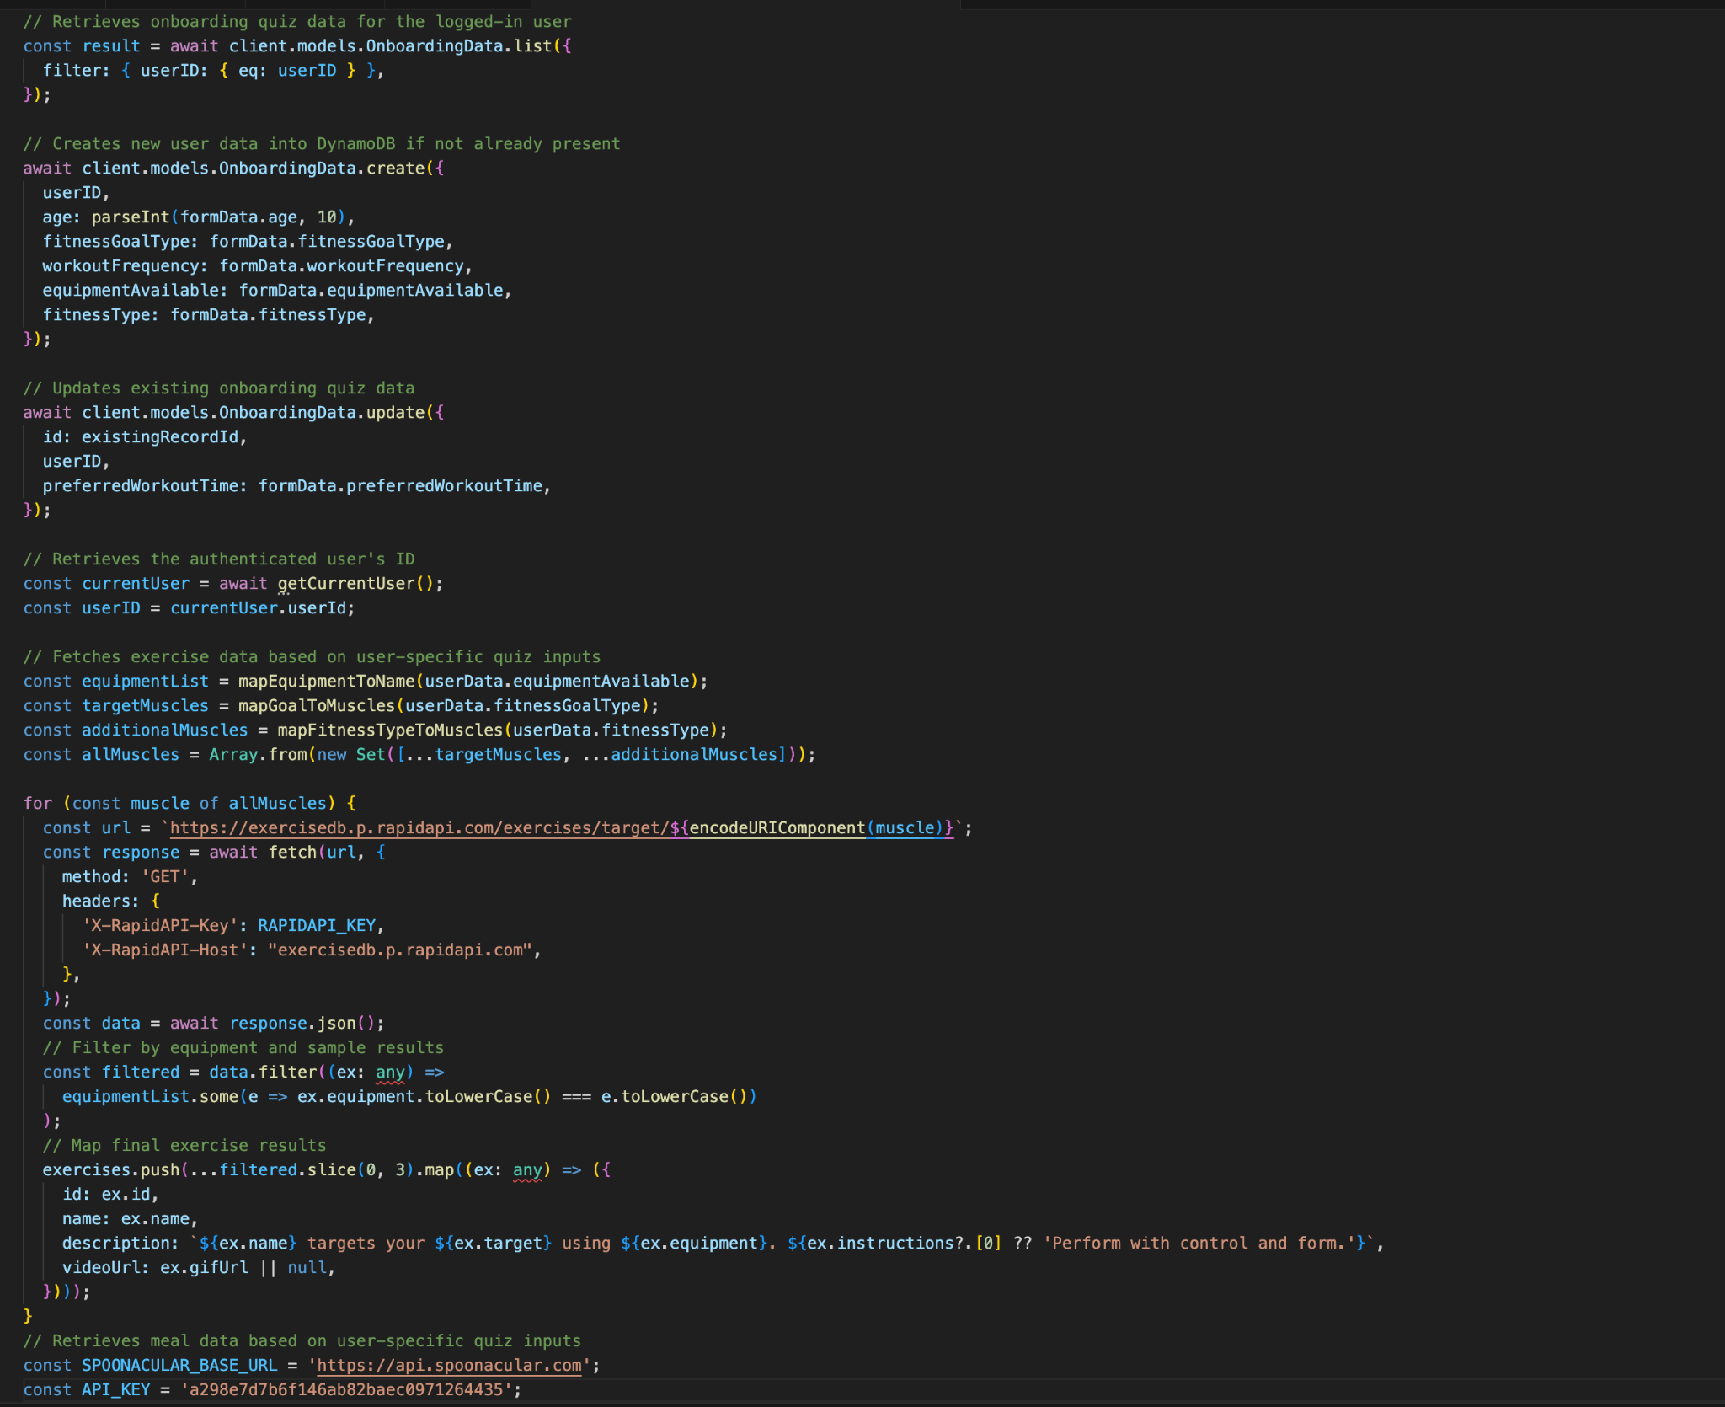
API
Notes:
What went well:
Quick decision: team members quickly established project idea as well as roles and responsibilities
Flexibility: team members were open to scheduling more meetings than necessary to get in alignment with each other for the project
Clarity: ideas started coming together as soon as the team started executing on respective action items, structuring the information on the slides, and getting clear on the working agreement
What can be improved:
Late planning: led to a rushed feeling, we did not know much about the project until January 25th when we could have started January 21st
Meeting structure: everyone needs to be clear on their own action items as well as other group members action items to be in sync
Communication: proactively letting the group know what they did on the project so other group members quickly test and verify it
What will we implement moving forward:
Implement a framework for our meetings moving forward where we know what exactly each of us is doing in the project at any moment in time
Team members will be asked to use the tracker to give themselves deadlines as well as check when tasks are complete
Update each other once every three days to see where everyone is with their responsibilities

Slide 63

THANK YOU
THANK
YOU
THANK
YOU
THANK
YOU
THANK
https://github.com/egasan21/8020fit

